Slide 1
Arctic Sea Ice in Community Earth System Model Version 2 (CESM2) and CESM2-WACCM
Ning, Chenhui
Department of Earth System Science, Tsinghua University, Beijing, China
Contact: nch21@mails.tsinghua.edu.cn
Notes:
Hi everyone, I’m Ning Chenhui from Department of Earth System Science. Today I will talk about the Arctic sea ice in the community earth system model.

Slide 2
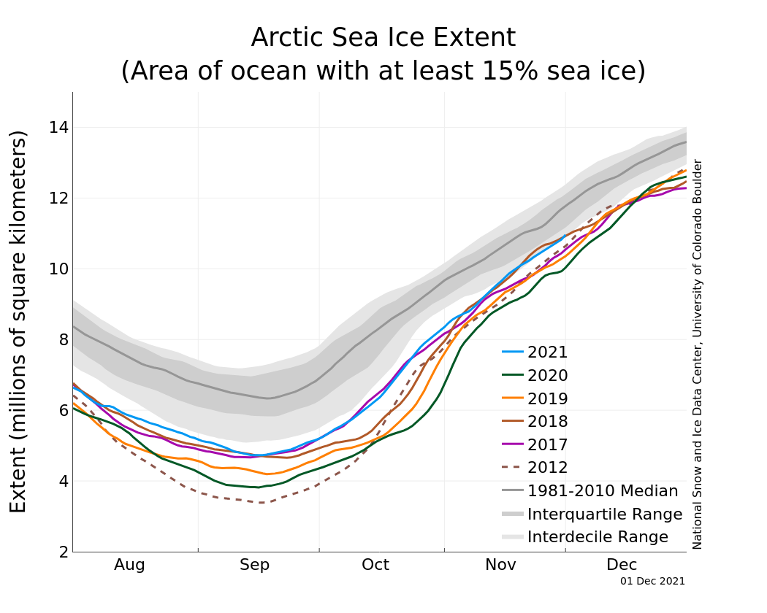
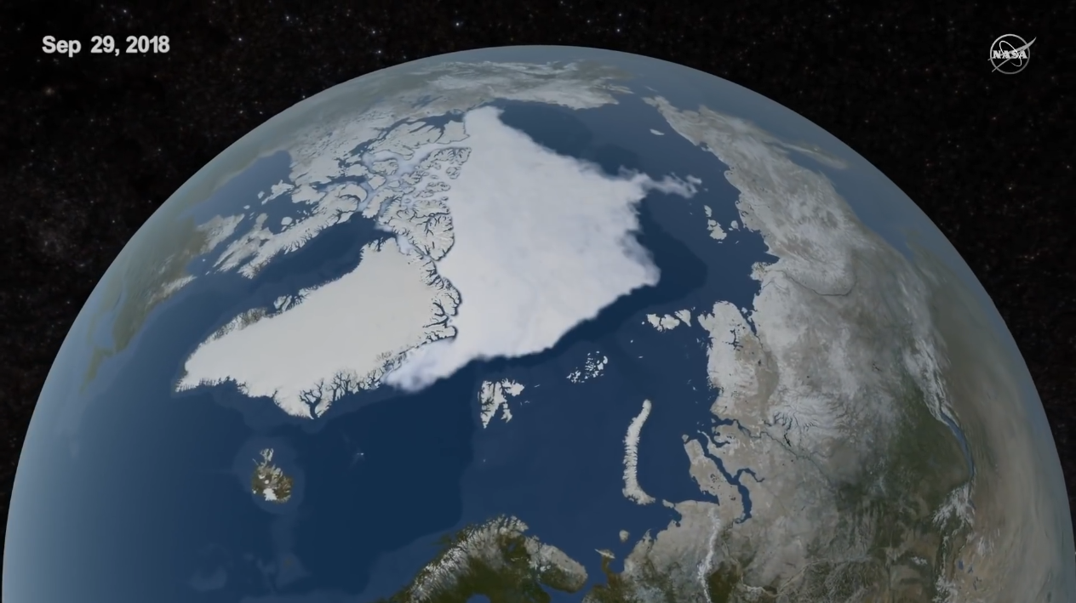
Introduction
Global warming
Changing earth
Affecting human beings
Arctic sea ice
Important part of earth's system
Affected by global warming
Downward trend
Will it disappear in the future?
NASA https://nsidc.org/arcticseaicenews/
Notes:
In the past hundred years, the global warming is changing the earth and affecting human beings.
Arctic sea ice is an important part of the earth system，and it is affected by the global warming.
The picture on the right shows the changes of the Arctic sea ice extent, in which the gray strip is the historical average, and the colored solid line below is for recent years. It is obvious that the sea ice extent has shown a downward trend，the minimum is from 7 to about 5 square kilometers.
Therefore, a very important question is, will the Arctic sea ice disappear in the future?

Slide 3
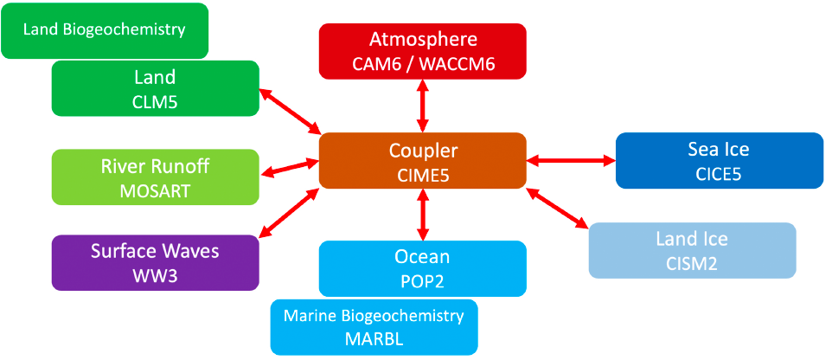
CESM2
Community Earth System Model, version 2
CESM: “low‐top” limited chemistry
WACCM: “high‐top” Higher atmospheric altitude, comprehensive chemistry
Danabasoglu, G., Lamarque, J. F., et al (2020).
Notes:
To study sea ice in global change，Earth system model is one of the important and irreplaceable research tools， it can simulate and predict climate change 。
The Community Earth System Model，CESM， is an state-of-the-art fully coupled global climate model.
In addition to the default configuration， it also provides a "waccm" configuration to simulate higher atmosphere and more complex chemical processes.

Slide 4
Questions
Can the CESM simulate realistic Arctic sea ice?
How does the WACCM configuration change from the default for Arctic sea ice? Which one is better?
Whether the CESM can predict the future Arctic sea-ice free? How much will the global temperature increase by then?
Notes:
So here comes the question...:
In order to answer these questions, we compared the sea ice results of cesm2 and cesm2 waccm

Slide 5
Method: Evaluation
Arctic, March & September
Total sea-ice area (SIA)
Total sea-ice volume (SIV)
Simulated Sensitivity
d SIA / d CO2
d SIA / d GMST (global annual mean surface temperature)
When the Arctic Ocean will practically be sea-ice free
Mean Quantities
Sea-ice area drop below $1 × {10}^{6} km^{2}$
Sea-ice area drop below 1 × 10^6 km^2
Notes:
The evaluation method of this study is as follows:
firstly, calculate the mean quantities, the total sea ice area SIA and total sea ice volume SIV of the Arctic in summer and winter,
and then analyze the sensitivity of the model, to evaluate the change in SIA for a given change in: CO₂ emissions, and global annual mean surface temperature (GMST).
Finally, evaluate the scenario when the Arctic Ocean will practically be sea-ice free, which is defined as the average sea ice area decreased to one million square kilometer in September.

Slide 6
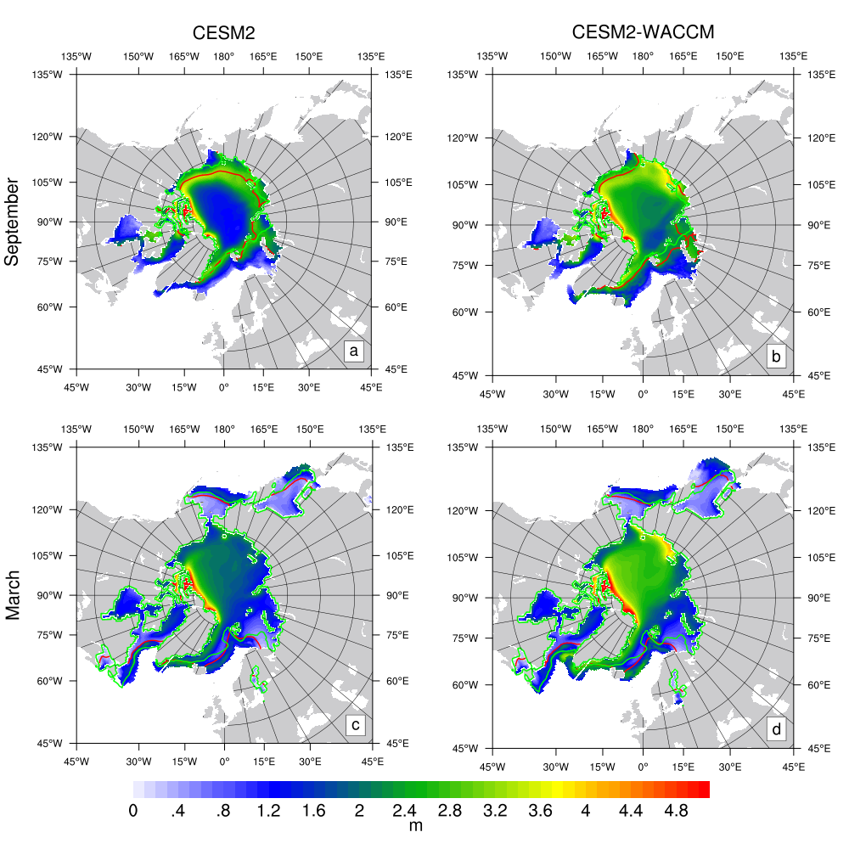
Results: Spatial
CESM significantly underestimates sea-ice extent in September
WACCM is in good agreement with the observed data
WACCM can simulate thicker sea ice than CESM2
Notes:
Next is our results.
Firstly, compare the spatial distribution of sea ice between the model and the observation.
Here, the red line is the simulated sea ice extent, the green line is the observation result, and the filling color represents the simulated sea ice thickness. It can be seen that in September, that is, summer, cesm significantly underestimated the sea ice extent, but waccm is in good agreement with the observed data.
Moreover, waccm can simulate thicker sea ice than cesm2, especially in the middle of the basin.
The thicker sea ice in waccm is considered to be related to the thicker clouds simulated by waccm in the Arctic.
The thicker sea ice in CESM2-WACCM is related to liquid Arctic clouds, which are thicker as a result of increased aerosol concentrations predicted from the interactive chemistry module (Gettelman, Mills, et al., 2019).

Slide 7
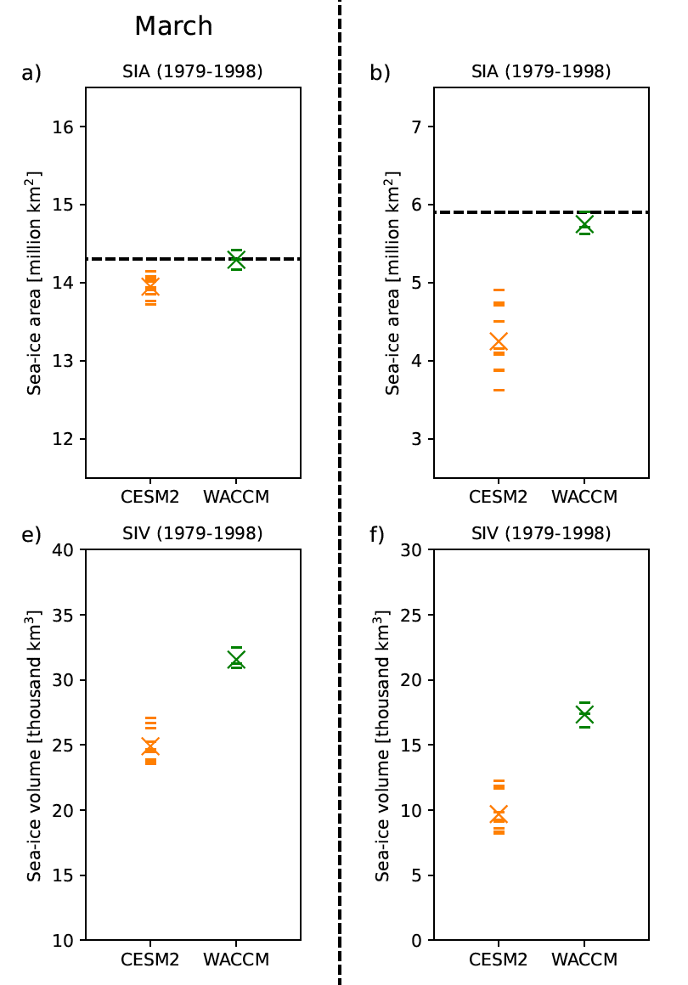
Results: SIA & SIV
September
Still realistic
SIA in March is very close to the observational estimate
A large spread across CESM simulations, underestimated
Substantial uncertainties
for reanalyzed and observed estimates of Arctic SIV
WACCM can simulate more sea ice than CESM
Notes:
For the sea ice area, Here, each short line represents one simulation. The black dashed line represents the observation results and the cross represents the ensemble average.
the SIA of the two configurations in March is very close to the observation estimation. For September, cesm‘s results have a wide range of uncertainty and are greatly underestimated, while waccm is still relatively accurate.
For sea ice volume, waccm simulates more sea ice than cesm2.
Here, we do not compare models with an observational estimate due to substantial uncertainties for reanalyzed and observed estimates of Arctic sea-ice thickness and thus volume
Due to the small difference of forcing, the results of each simulation are also different.

Slide 8
Results: Sensitivity
September
Models are more sensitive than reality
CESM ensemble has a larger spread and its ensemble mean is closer to the observational estimate
Might indicate CESM is better than WACCM on a process level
Notes:
For sensitivity analysis, it can be seen that models are more sensitive to co2 than reality,
And CESM2 ensemble has a larger spread and its ensemble mean is closer to the observational estimate。
Therefore, it Might indicate CESM2 is better than WACCM on a process level.
It is, however, unclear whether this reflects difference between models because the small sample size of CMIP2-WACCM

Slide 9
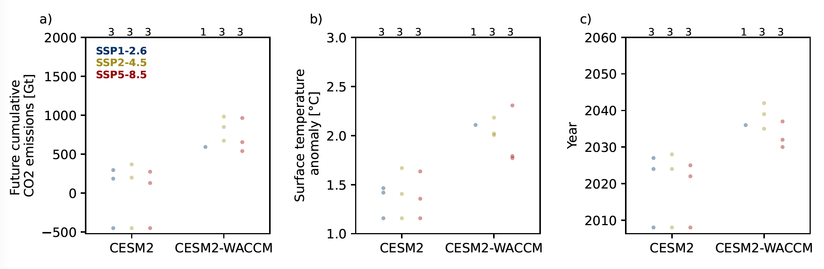
Results: When practically sea-ice free …
WACCM needs more CO2 emissions and global warming than CESM (Also more realistic)
First year of practically sea ice-free ranges from 2030 to 2050 for WACCM
Notes:
At last, the prediction of sea ice free.
because waccm can simulate more sea ice, it needs more CO2 emissions and temperature rise to achieve sea ice free.
Finally, what we most concerned. Are shown on the right。 Waccm predicts that the First year of practically sea ice-free ranges from 2030 to 2050
Shared Socioeconomic Pathway，数字越大排放越高
WACCM compares favorably with the range of 800 ± 300 Gt estimated from a direct analysis of the observed sensitivity, while CESM2 has underestimated.

Slide 10
Summary
Thank you!
Both models’ sea-ice area are more sensitive than observed to CO2
The CESM2-WACCM simulates more realistic sea-ice area and extent than CESM2
The CESM2-WACCM projects that the Arctic will become practically sea ice free (sea-ice area drop below ${1 × 10}^{6} km^{2}$ in September) before the year 2050
The CESM2-WACCM projects that the Arctic will become practically sea ice free (sea-ice area drop below 〖1 × 10〗^6 km^2 in September) before the year 2050

